Slide 1
Our CitY
Demo presentation

Slide 2
OUR CITY
Racing game
Free city moving
Mission

Slide 3
AI
Racing Lines
Line from POI to POI
Calculate additional POI to line
Randomize select next POI
Load from XML
Map POI Editor
Create racing lines
Create ingame mission
Create racing circuits

Slide 4
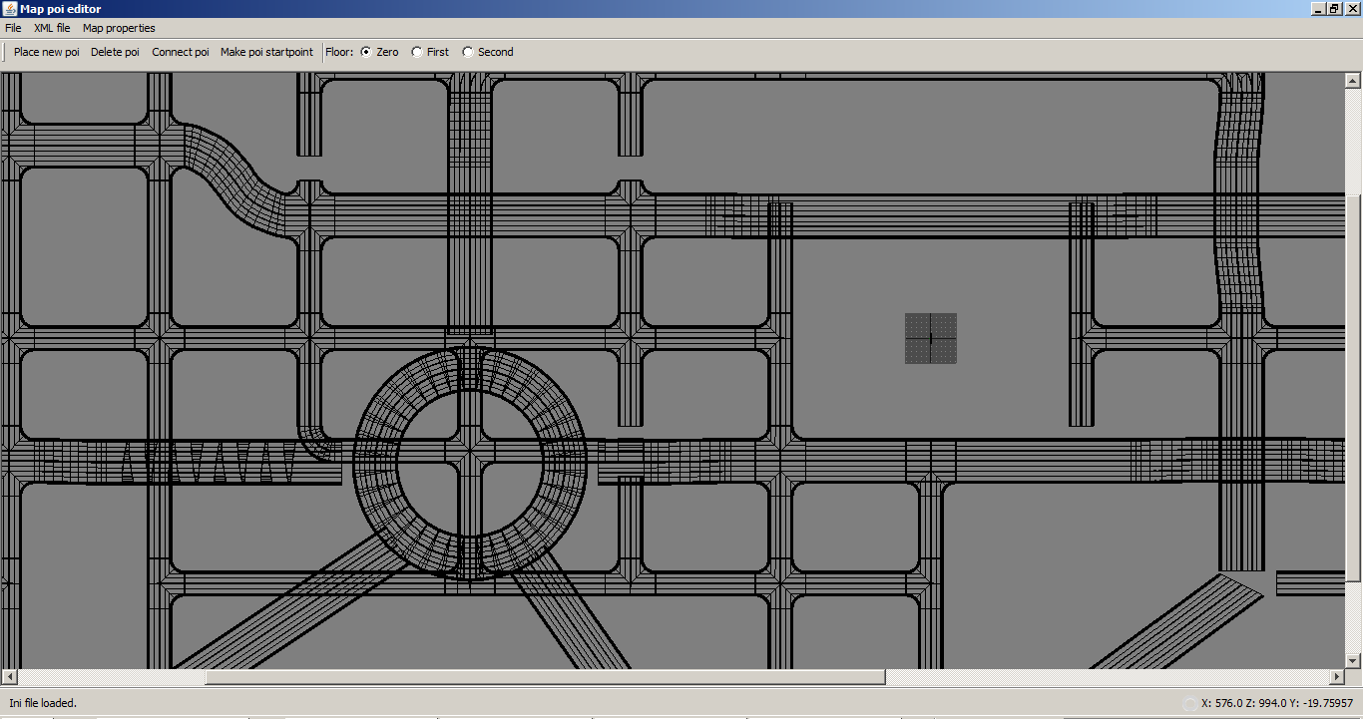
Map POI editor

Slide 5
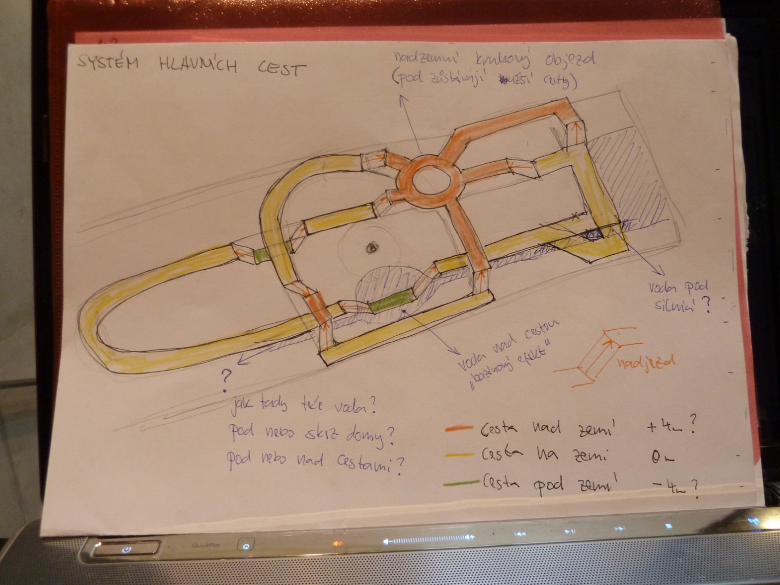
Roads

Slide 6
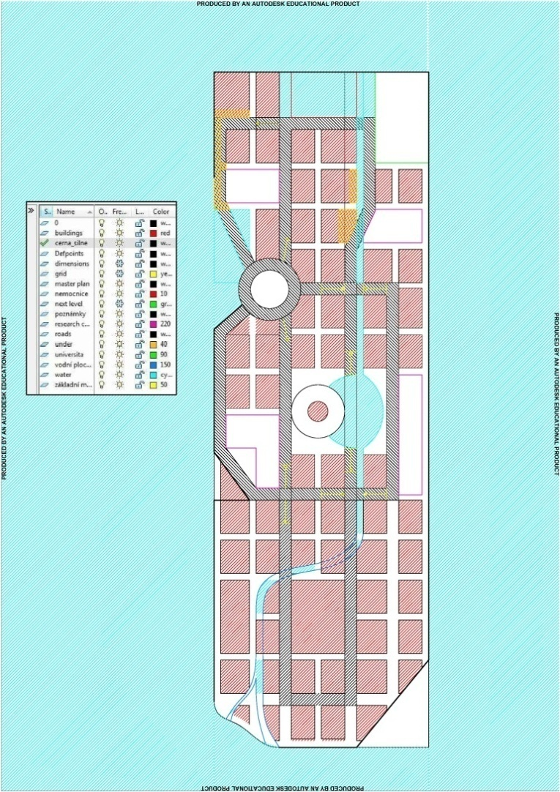
Roads

Slide 7
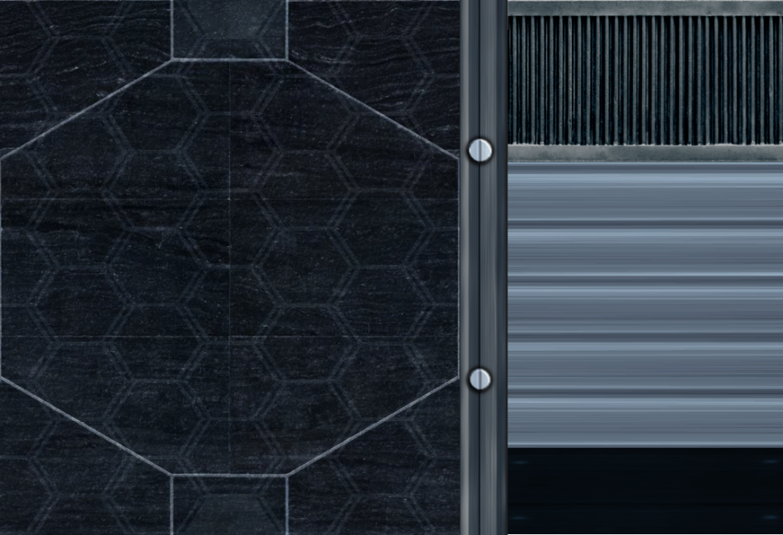
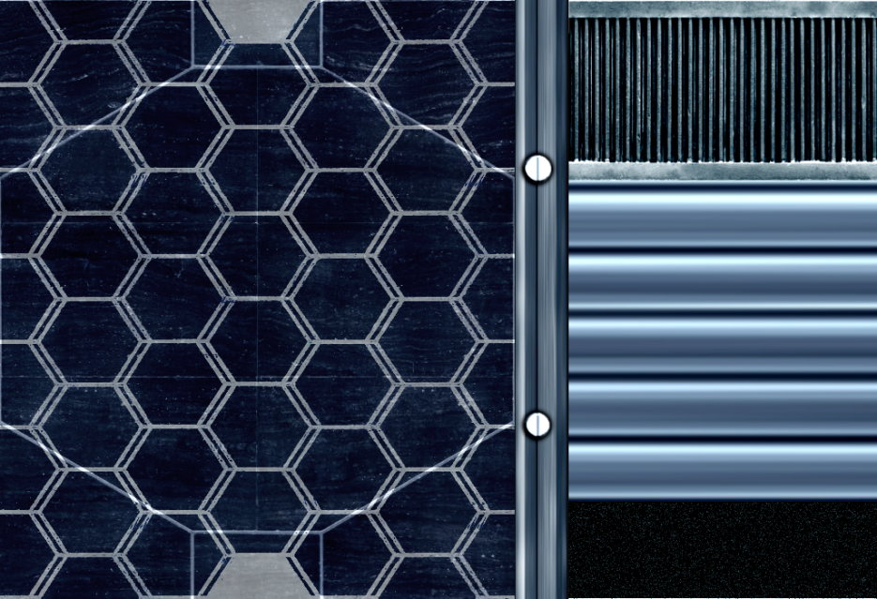
Roads
Diffuse Texture
Specular Texture

Slide 8
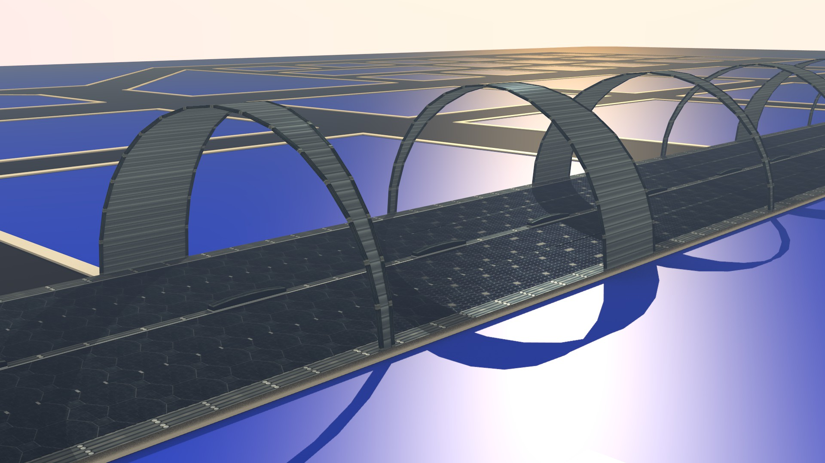
Roads

Slide 9
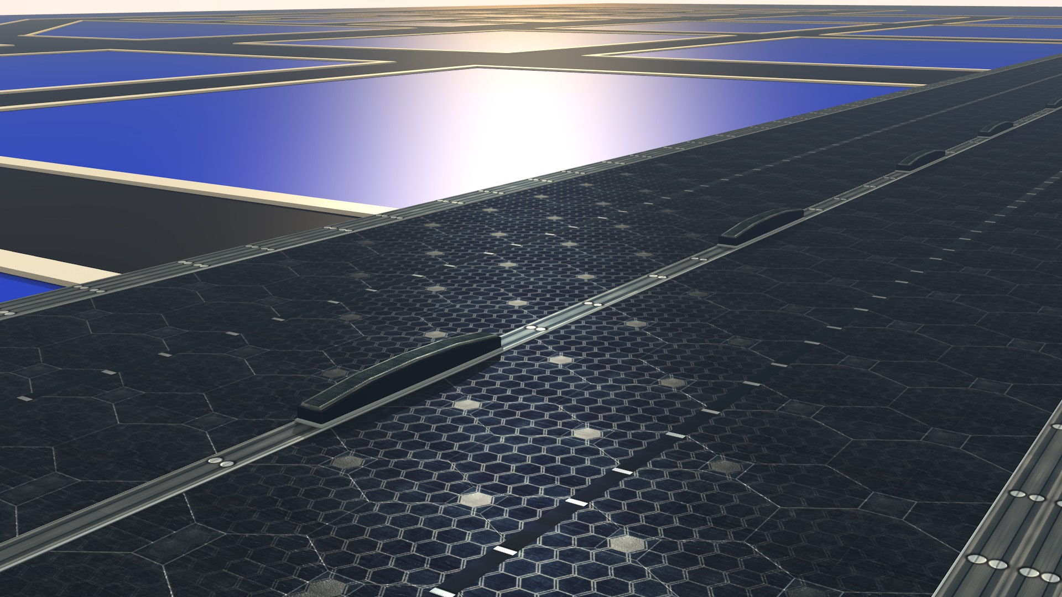
Roads

Slide 10
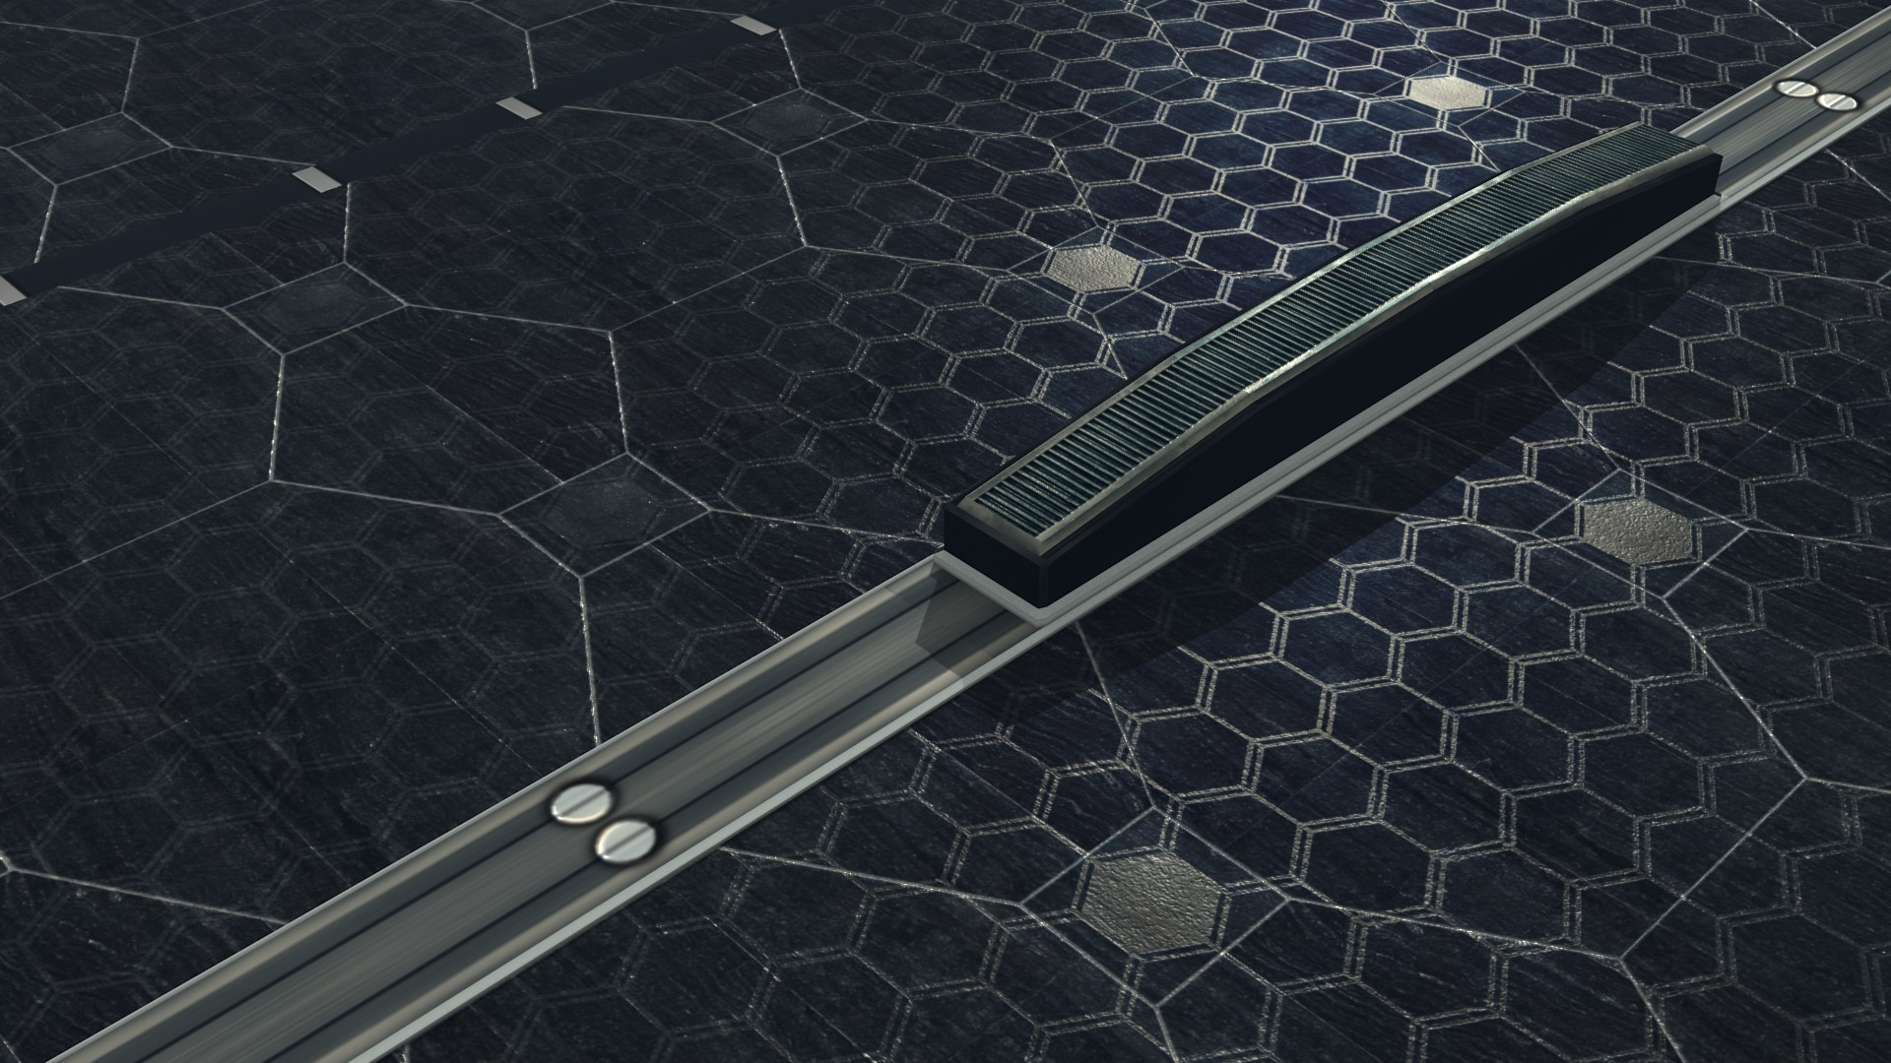
Roads

Slide 11
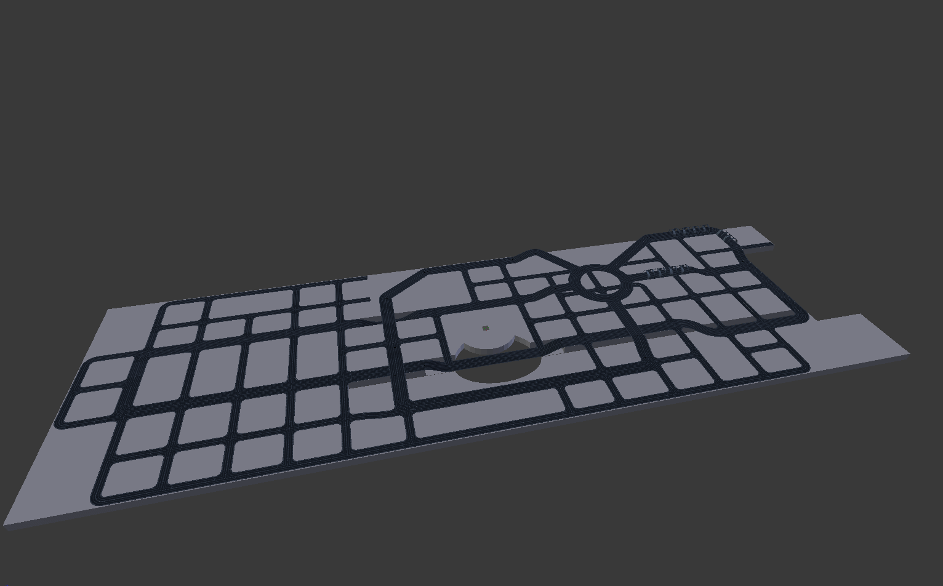
Roads

Slide 12
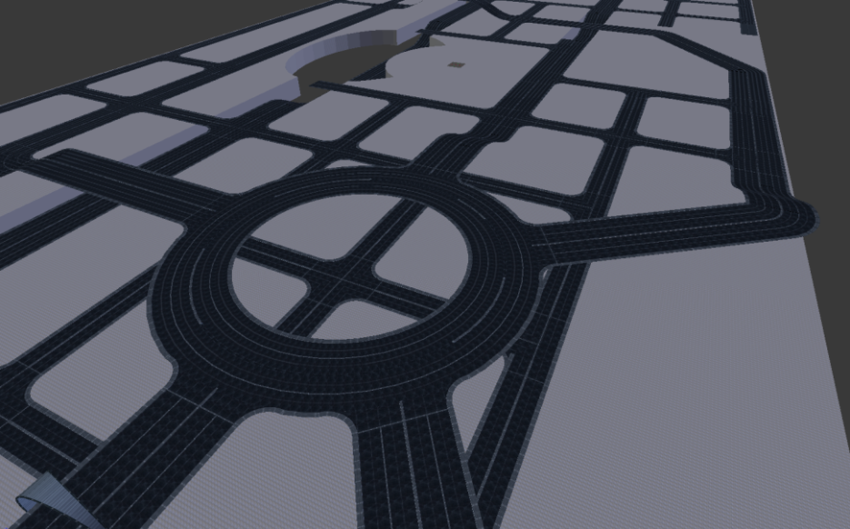
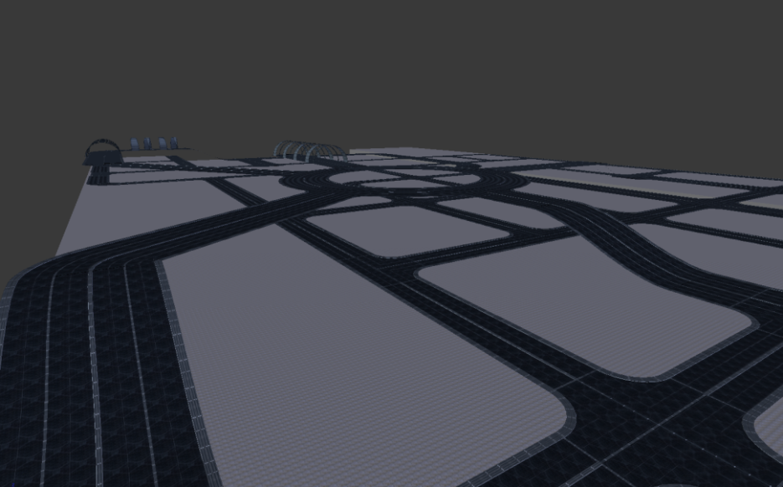
Roads

Slide 13
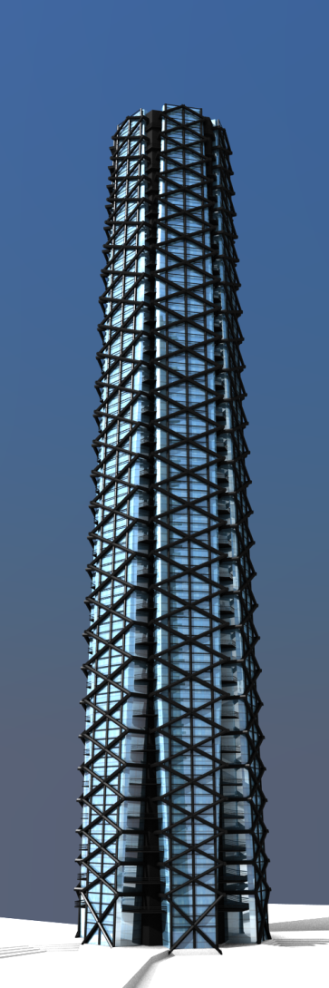
Head Quarters

Slide 14
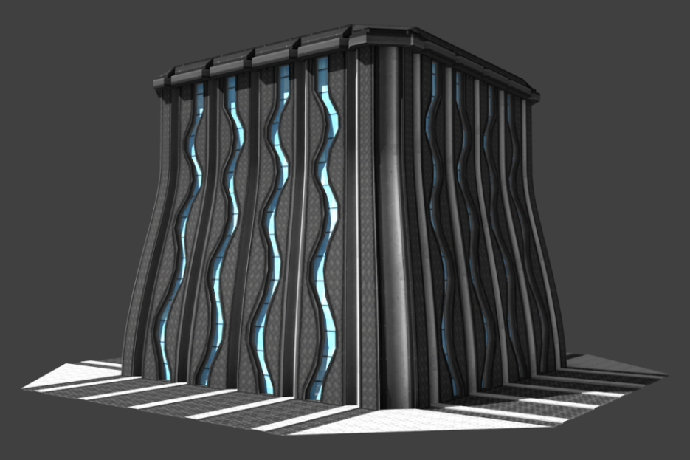
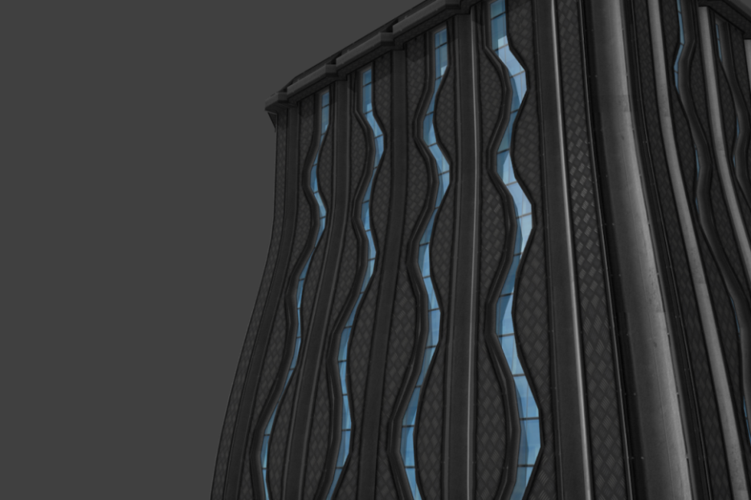
Ox Factory

Slide 15
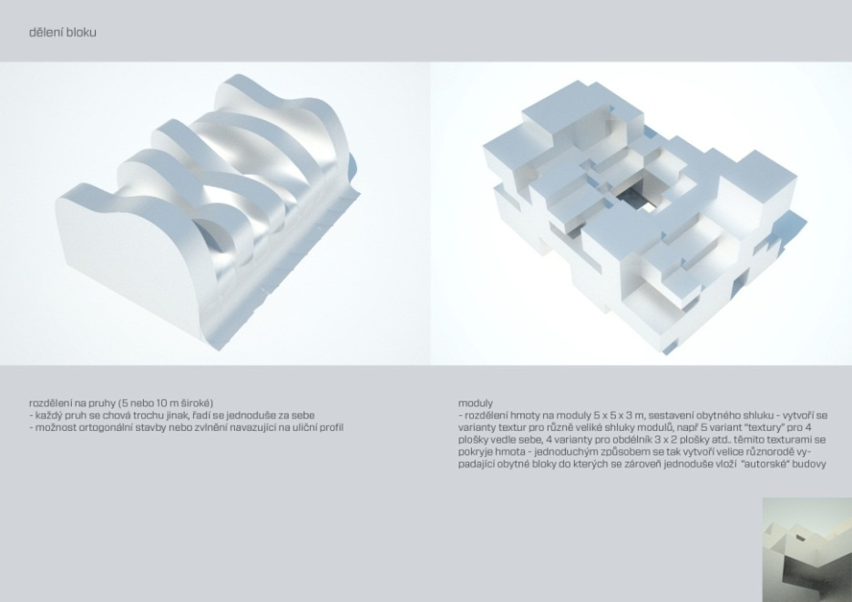
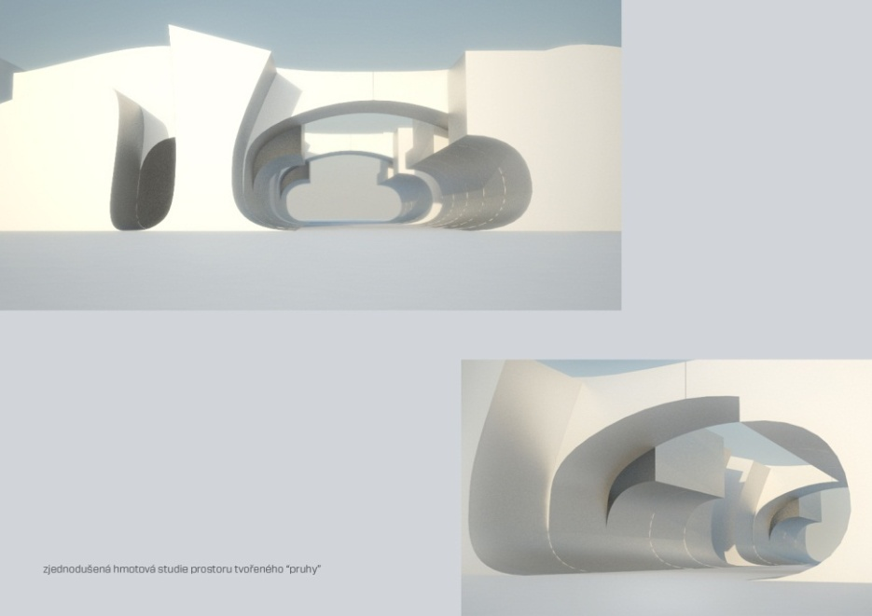
Building Mass

Slide 16
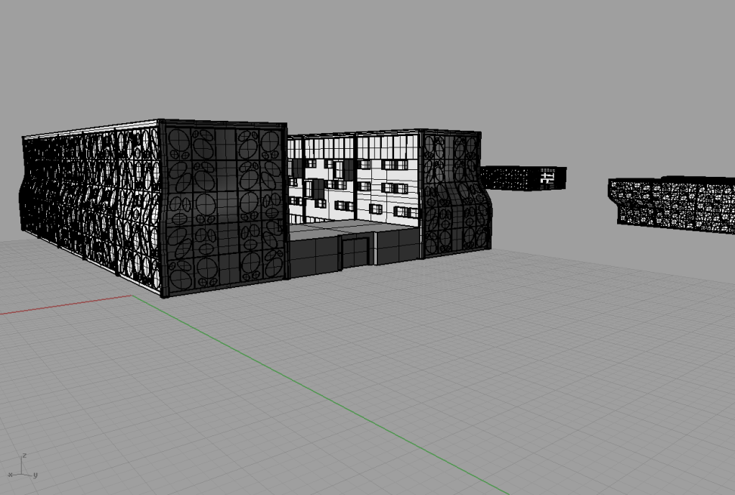
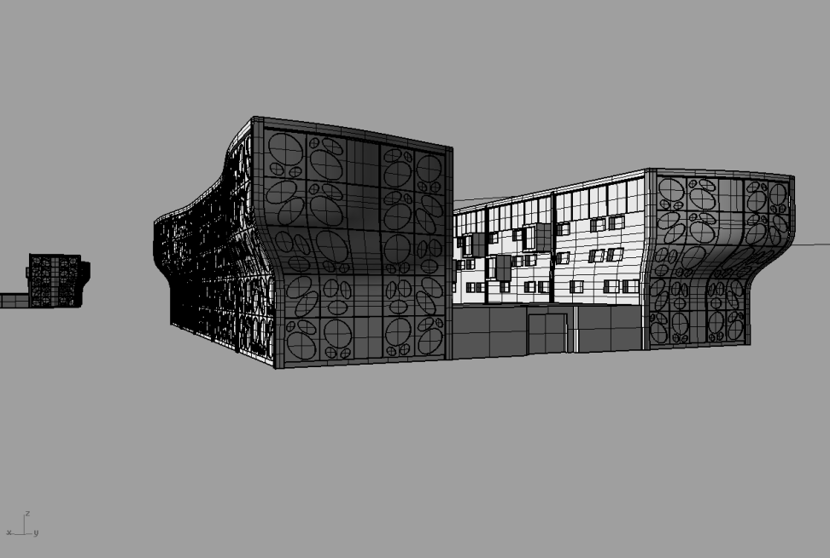
Block Types

Slide 17
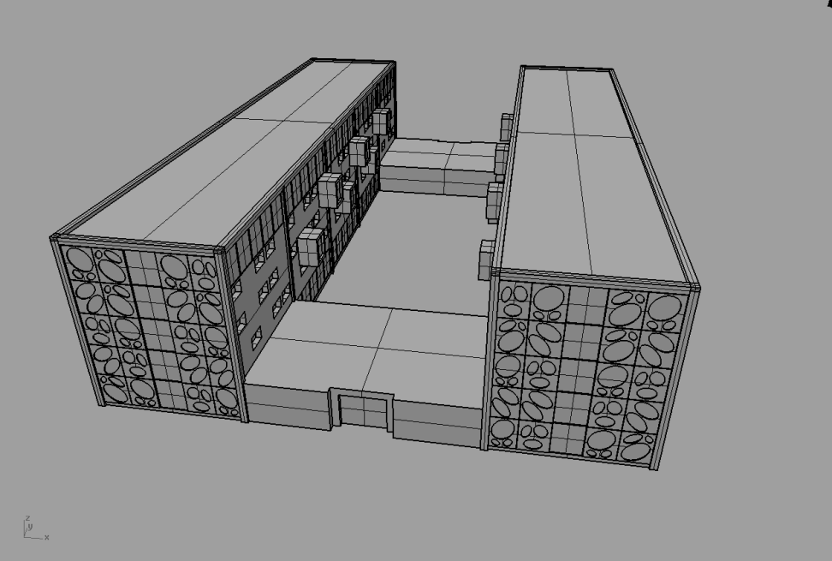
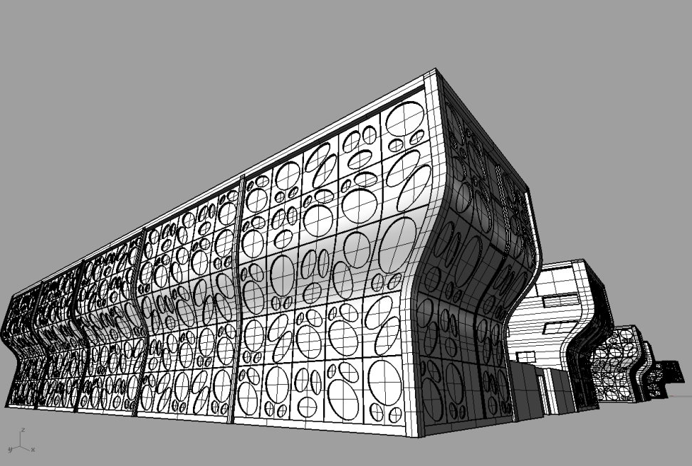
Block Types

Slide 18
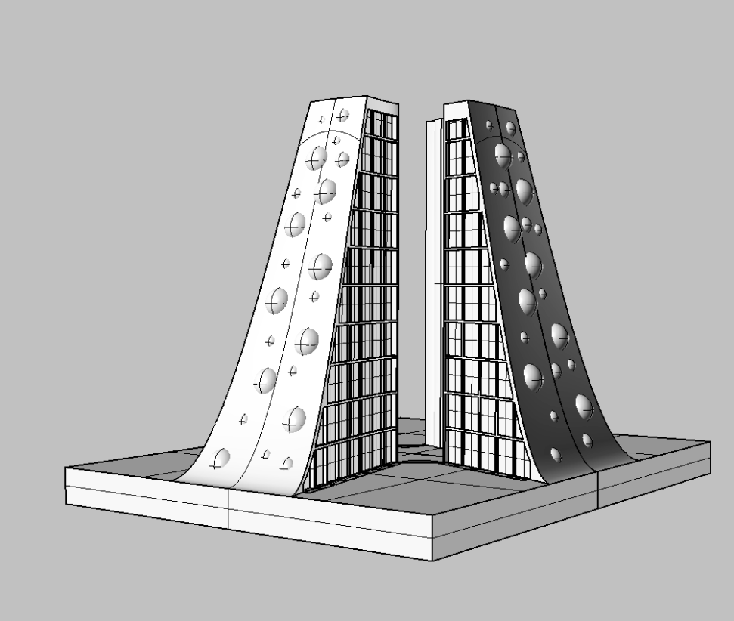
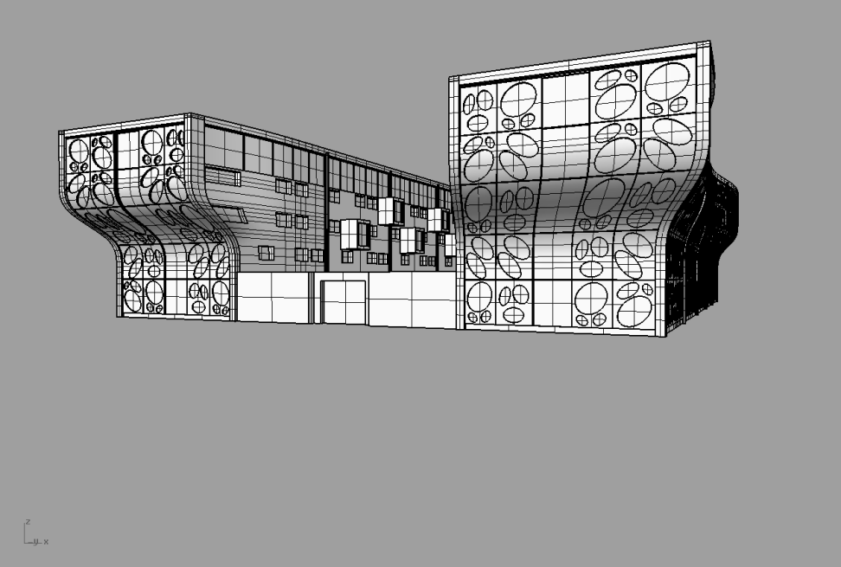
Block Types

Slide 19
Music
Original soundtrack
(4 tracks)

